Slide 1
Mini-Project Approval
Project Title : MEDISURE – A 24hr Health Care
Project Guide : Prof. RAGHU B A
Project Team : SHIVANGI RAJ PES1201700098
SAIONI CHATTERJEE PES1201700118

Slide 2
Problem Statement
Nowadays, due to the busy day-to-day routine life, people hardly find time to take care of their own health.
Thus, consequently they start neglecting any minor issues.
We are designing a web portal to meet the medical needs corresponding to the problems specified by the patient.

Slide 3
Literature Survey
List the papers/references studied
Online sources(Practo.com), published paper –
Practo technology: the online way of life!
Chauhan, R., Kumar, A. and Singh, H., 2015. Lessons from startup for energising online patient care. International Journal of Technology Marketing, 10(2), pp.195-208.
Dr Brajesh Kumar Singh (ortho), Patna
Dr Anita Singh (Obstetrics, Gynaecologist), Patna
Dr Chhaya Tanmane (Gynaecologist), Nagpur
Difficulties faced in searching for doctors and clinics especially
to facilitate the old aged people in getting all required medicines at their doorstep.

Slide 4
Proposed Solution
We are designing a website to meet the doctor selection by providing details of the top specialists, clinics nearby as specified by the patient.
If a person is in need of a specialist such as a gynaecologist or orthopaedic, etc, they will be getting an option to select the doctor available.
If the patient is looking for a regular check up, for them we will be providing the details of the doctors and the appointment facility.

Slide 5
Proposed Solution
The patient will be asked to enter necessary information and the symptoms of the disease he is suffering from, while booking an appointment.
We further store the prescription given by the doctor to the patient for reference, for example, if the patient again meets the same doctor, the respective doctor will get a pre information about the patient.

Slide 6
Technologies / Methodologies
Languages / Technologies –
HTML
CSS
JavaScript
PHP
SQL - MySQL
Bootstrap

Slide 7
Project Timelines & Plan
WEEK | PLAN
1-2 | literature survey, figuring out what the web portal should contain
3-5 | Presentation and Home Page. And drawing the ER diagram and relational schema and writhing the SQL commands
6-7 | Collection of data of doctors, create database tables.
8-9 | Develop backend and design frontend.
10-11 | Completing the small bits left like designing the receipt that will be send to patient after the appointment,
12 | Report Writing and final presentation.

Slide 8
Thank You

Slide 9
Any other information
HOME PAGE
The first page of our website consists of a search box asking for the requirements of the user, whether he’s in need of information regarding medicines or doctors or clinics.
The customer will be provided with options like chat with doctor , order medicines ,book an appointment or other queries .
In order to order medicine or book an appointment the user is expected to sign in to our website or create an account .
The home page will give an overall view of the top specialists, deals and offers, health tips or deals regarding check up , clicking on which the user will be directed to the respective pages.

Slide 10
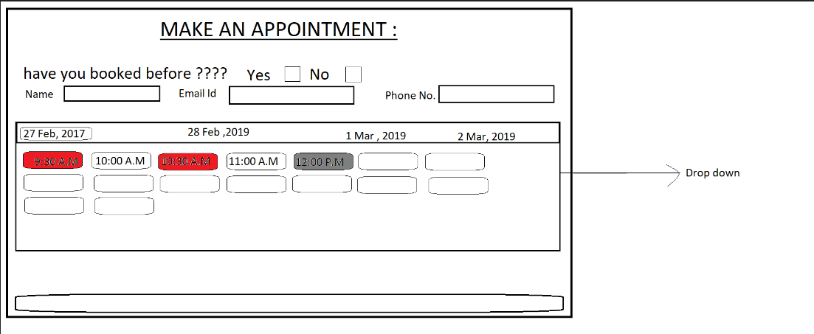

Slide 11
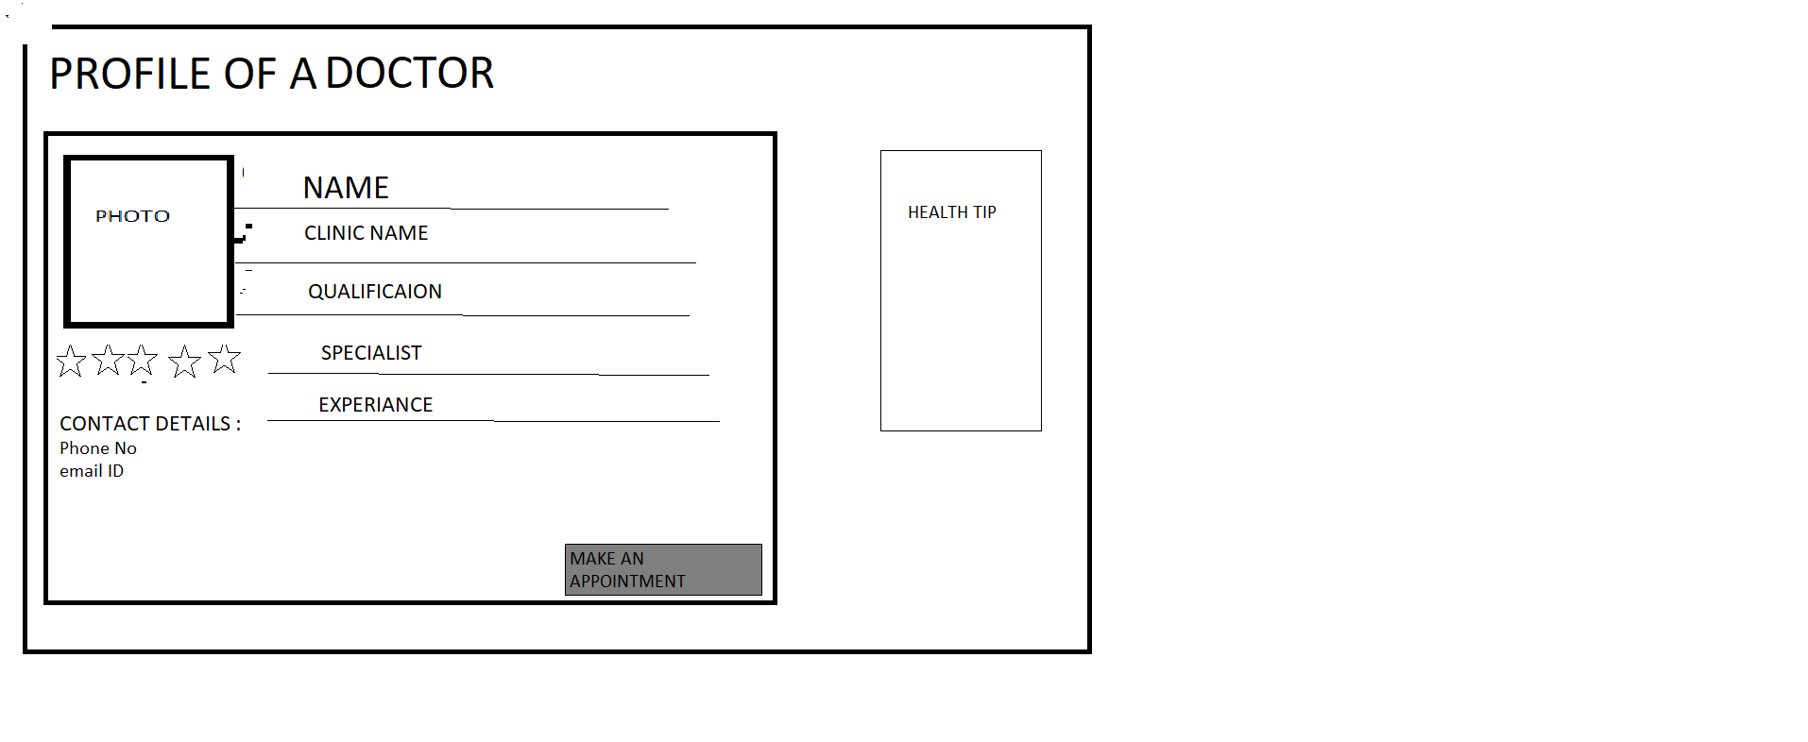

Slide 12
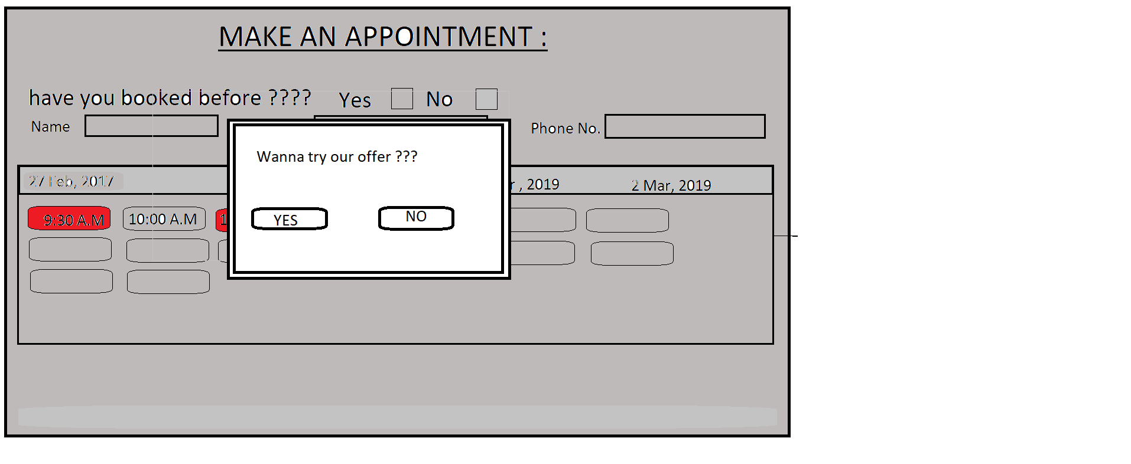

Slide 13
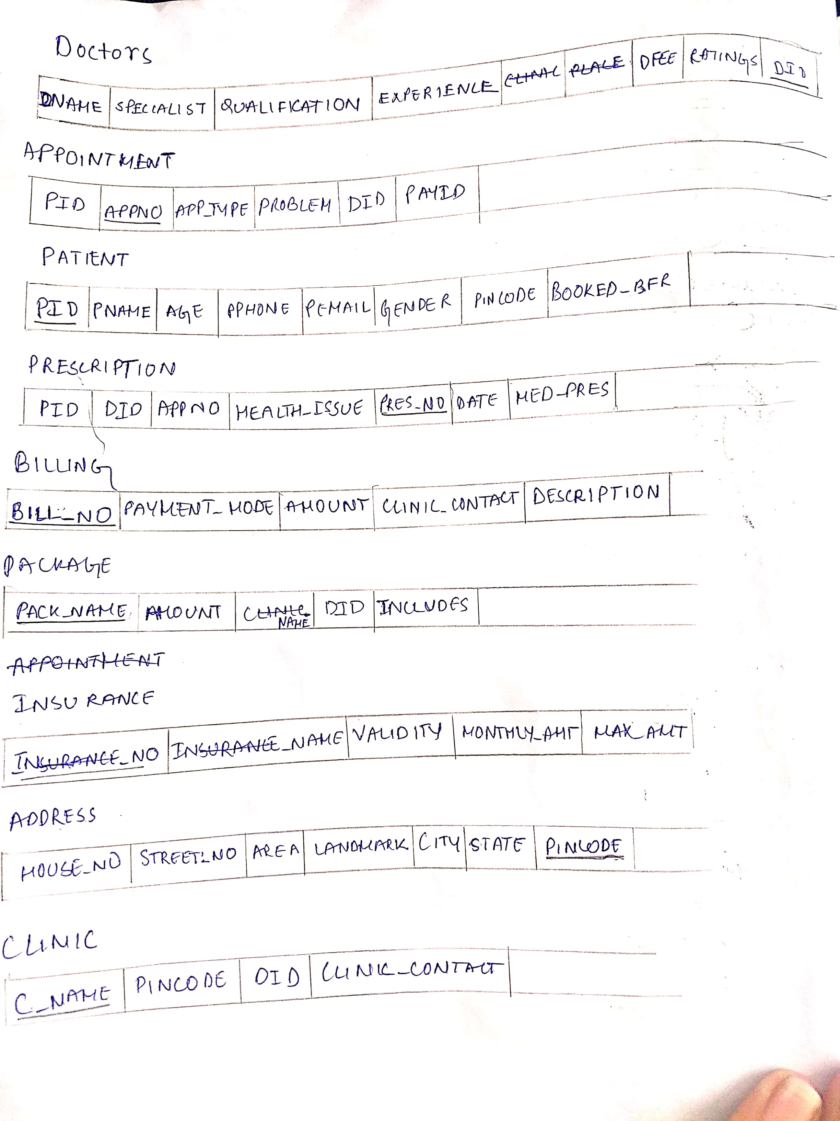

Slide 14
Project Timelines & Plan
Week 1-2 : literature survey, figuring out what the web portal should contain.
Week 3-5 : Presentation and Home Page.
Week 6-7: Collection of data of medicines, doctors, create database tables.
Week 8-9 : Develop backend and design frontend.
Week 10-11: the entire project.
Week 12 : Report Writing and final presentation.

